Slide 1
Employee Attrition and Salary Analysis
Roslyn Smith
April 16, 2022

Slide 2
Data Adjustments
Adjustments to data provided - I excluded employee unique identifiers as well as columns with same data from the analysis to better group employees and reduce dataset. In addition, I converted the Attrition Yes / No indicators to binary 0/1 in order to better run a model.
Columns Excluded
Employee Unique Identifiers
ID and Employee Number
Columns with no differentiation in data
Employee Count: Value is all 1
Over 18: Value is all Yes
Standard Hours: Value is all 80 hours

Slide 3
Attrition Model Create an initial model to determine significant variables that impact attrition
In running a linear regression model with all variables, the variables with the most significance were:
Overtime completed
Job Involvement
Job Satisfaction
Number of Companies Worked
Marital Status
 | Estimate | Std. Error | t value | Pr(>|t|)
Over Time | 0.21 | 0.02 | 8.66 | 2.00E-16
Job Involvement | (0.08) | 0.02 | (5.18) | 2.73E-07
Job Satisfaction | (0.04) | 0.01 | (4.35) | 1.52E-05
Number of Companies Worked | 0.02 | 0.01 | 4.09 | 4.78E-05
Marital Status | 0.14 | 0.04 | 3.35 | 8.42E-04
All these variables were considered significant at a 99.9% level with p-values less than 0.001.

Slide 4
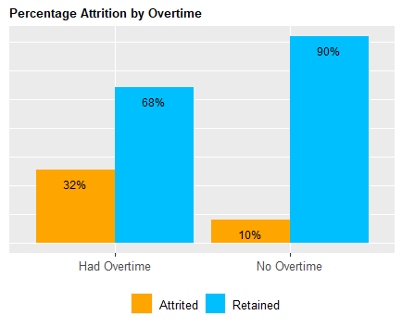
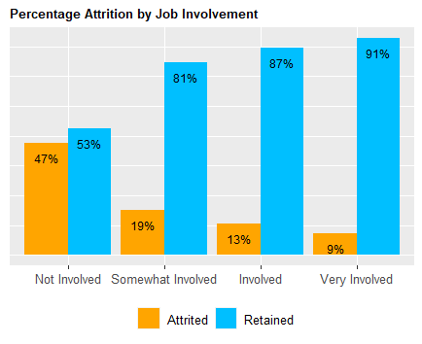
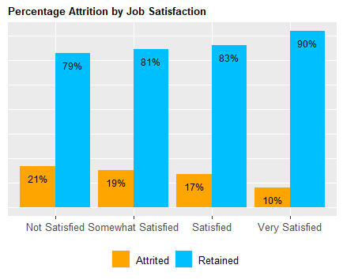
Attrition vs. Top 3 Significant Variables
The column chart shows a higher percentage of employees who worked overtime also attrited.
As job involvement increases, we see a decrease in attrition.
Similar to job involvement, we see an inverse trend with job satisfaction and attrition.

Slide 5
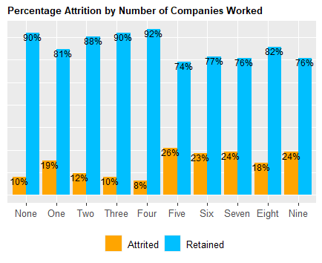
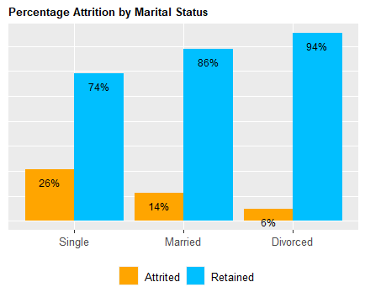
Attrition vs. Other Significant Variables
As there is an increase in the number of companies the employees worked with, we see an increasing trend of attrition.
Employees’ personal life also impact attrition. There is a higher proportion of single employees that attrited when compared to married or divorced employees.

Slide 6
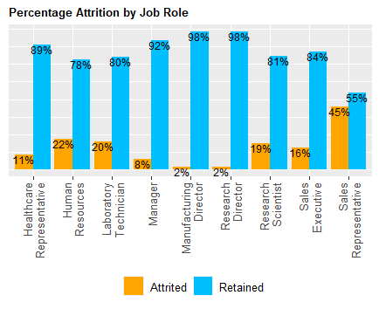
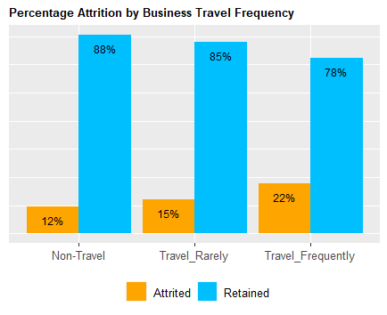
Attrition vs. Additional Variables
There is significantly higher attrition in the Sales Representative role which is not replicated in any other role.
There is also an increasing trend of attrition as the volume of business travel also increases.

Slide 7
Classifying Attrition
Naïve Bayes model was used in order to classify attrition. 75% of the employee data was split into a training set and the remaining was used as a test set in order to test the accuracy of the model. The metrics used for the model were:
Age
Business Travel
Department
Distance from Home
Education Level
Environment Satisfaction
Hourly Rate
Job Involvement
Job Level
Job Role
Job Satisfaction
Marital Status
Monthly Income
Overtime
Performance Rating
Relationship Satisfaction
Total Working Years
Work Life Balance
Years At Company
Years In Current Role
Years Since Last Promotion
Years With Current Manager
In using these variables, we were able to get 88% accuracy in the prediction, sensitivity of 93.3% (the ability to properly classify people who attrited) and a specificity of 62% (the ability to properly classify people who did not attrite).

Slide 8
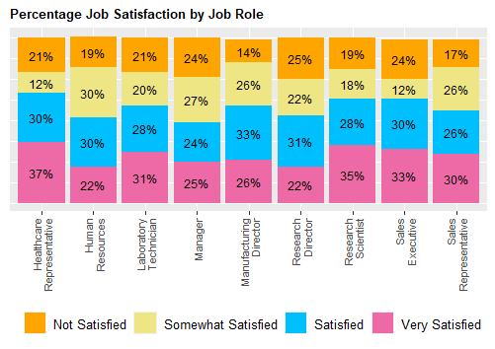
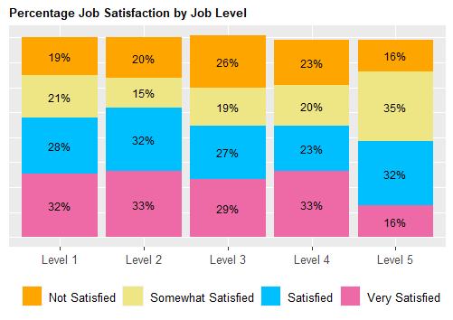
Additional Insights
Generally all roles are more than 50% Satisfied or Very Satisfied (3 or 4 in response). Manager roles were at 49% in those two categories.
We do see a decreasing trend of job satisfaction as the job level’s increase with Level 5 roles having the least proportion of employees rating a 4 in Job Satisfaction.

Slide 9
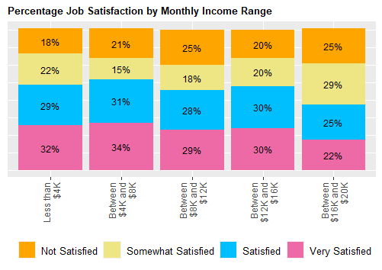
Additional Insights
Similar to job levels, the higher paid employees then to be less satisfied.

Slide 10
Predicting Monthly Income
A linear regression model was used in order to predict income. Similar to classifying attrition, 75% of the employee data was split into a training set and the remaining was used as a test set in order to test the accuracy of the model.
The initial linear model was run without any filters on variables to determine the best variables to include. Based on the results, the metrics used for the model were:
Business Travel Frequency
Job Level
Job Role
Total Working Years
Years Since Last Promotion
In using these variables, we were able to get a Root Mean Square Error (RMSE) of 1,122. The RMSE measures how concentrated the data is around the line of best fit.

Slide 11
Questions?
Contact Information: Roslyn Smith (roslyns@mail.smu.edu)
Thank You!

